Slide 1
Vaginal and Vulvovaginal Disorders
郭沁怡 藥師
台北醫學大學附設醫院 藥劑部

Slide 2
Outline
1. Anatomy and physiology of the vagina
2. Differentiation of common vaginal infections
3. Vulvovaginal candidiasis
4. Atrophic vaginitis
5. Vaginal douching

Slide 3
Introduction
Vaginal symptoms are among the most common health concerns of women.
65％ of women who experience vaginal symptoms have a vaginal infections.
Common vaginal infections:
  Bacterial vaginosis (BV) 細菌性陰道炎：33%，處方藥抗生素治療
  Vulvovaginal candidiasis (VVC) 念珠菌陰道炎：20~25%，可以OTC藥物治療
  Trichomoniasis 陰道滴蟲病： 15~20%，由性行為傳染
Bacterial vaginosis 和 Trichomoniasis
可能會導致嚴重後遺症/併發症，需轉介醫生處理

Slide 4
Outline
1. Anatomy and physiology of the vagina
2. Differentiation of common vaginal infections
3. Vulvovaginal candidiasis
4. Atrophic vaginitis
5. Vaginal douching

Slide 5
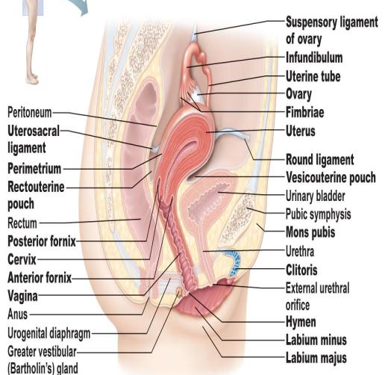
Anatomy & Physiology of Vagina
Vagina lies between the urinary bladder and the rectum.
The upper end of the vagina is closed expect for the cervical os(子宮頸口).
At the lower(vulvar外陰) end of the vagina are the Bartholin’s gland (前庭大腺) .
  Produce secretions with sexual stimulation.

Slide 6
Vagina Protective Mechanism
Estrogen
  At puberty, estrogen influence the vaginal lining changes to stratified squamous epithelium (複層鱗狀上皮).
  Stratified squamous epithelium ：
        Contain glycogen ，Lactobacillus bacteria分解成lactic acid
        Lactic acid maintain vagina pH within 4 ～4.5.
        Lactobacillus bacteria produce hydrogen peroxide
  Acidic environment protect vaginal from bacteria infection
  Vaginal lining thinning in postmenopausal
  → Lactobacilli decline → increase pH
  → increase infection risk

Slide 7
Vagina Protective Mechanism
Secretions: Leukorrhea (白帶)
      Cleanse & lubricate vagina
      Odorless, transparent/whitish, viscous
      Factors that increase secretion:
          Ovulation
          Pregnancy
          Following menses
          Sexual excitement/emotional flares
      Other influencing factors
          Douching, oral contraception, fragrance, tampon

Slide 8
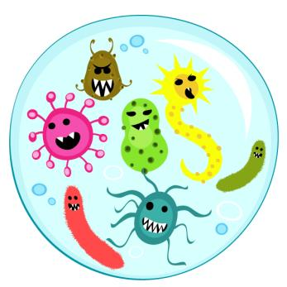
Vagina Normal Flora
Lactobacillus species: 90-95%
Others (more anaerobes) : 5-10%
Corynebacteria
Streptococcus
Staphylococcus epidermidis
Gardnerella vaginalis
Peptostreptococcus
Bacteroides
E.coli、Candida albicans

Slide 9
Factor influencing vaginal environment
Number and type of endogenous organisms
Vaginal pH
Glycogen concentration
Hormonal fluctuations of the menstrual cycle
Aging
Certain disease(e.g. diabetes mellitus)
Medications use(e.g. contraceptive preparations, hormones and antibiotics )
Douching
Number of sex partners
Notes:
4.用經周期的波動

Slide 10
Course Overview
1. Anatomy and physiology of the vagina
2. Differentiation of common vaginal infections
3. Vulvovaginal candidiasis
4. Atrophic vaginitis
5. Vaginal douching

Slide 11
Differentiation of common vaginal infections (1)
陰道炎 | 症狀 | 分泌物特徵 | 陰道 pH值 | 併發症
Bacterial vaginosis 細菌性陰道炎 | 分泌物增多、有異味 搔癢等症狀較輕微 | 稀薄 如水狀 白、綠或灰色均質分泌物 有時成泡沫狀 魚腥味 | 增加 (>4.5) | PID,UTI Cervicitis 子宮頸炎 Endometriosis 子宮內膜異位 早產兒 胎兒體重過輕 增加得到HIV的機率
Trichomoniasis 陰道滴蟲炎 | 分泌物增多、有異味 陰部搔癢 外陰部紅腫 排尿疼痛 | 大量 黃綠色泡沫狀 異味 | 增加 (>4.5) | 胎兒體重過輕 tubal infertility 輸卵管性不孕 增加得到HIV的機率
vulvovaginal candidiasis 念珠菌陰道炎 | 分泌物增多 陰道搔癢 陰道灼熱感 外陰部紅腫 排尿疼痛 | 濃稠 白色似乳酪 無味 | 正常 (<4.5) | 增加其他感染症的風險
BV和Trichomoniasis均會導致陰道的pH值上升。
病人的分泌物若有異味，就應該立刻轉介給醫生

Slide 12
Differentiation of common vaginal infections (2)
BV 和 trichomoniasis 可能會導致嚴重後遺症或併發症，都需轉介醫生處理
BV 和 trichomoniasis 容易引起下列疾病：
  Pelvic inflammatory disease (PID) 骨盆炎
  Urinary tract infections
  Cervicitis 子宮頸炎
  Preterm labor 早產
  Tubal infertility 輸卵管性不孕
  Facilitation of transmission of HIV
Trichomoniasis為最常見的性病之一，病人及性伴侶均需接受治療，暫時避免性行為，以免交叉感染

Slide 13
Outline
1. Anatomy and physiology of the vagina
2. Differentiation of common vaginal infections
3. Vulvovaginal candidiasis
4. Atrophic vaginitis
5. Vaginal douching

Slide 14
Vulvovaginal Candidiasis (VVC) 外陰陰道念珠菌感染
Yeast infection and moniliasis
      80%~90% caused by C. albicans
      C. glabrata 、C. tropicalis 、Saccharomyces cerevisiae increasing in the past decades
Second most common after BV
Not common occur before menarche
By 25 ages women may experience >1x (50%)
Black women > white or another
Few (5%) will occur recurrent infection (defined as 4 or more infections within one year period)

Slide 15
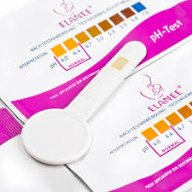
Clinical Presentation of VVC
VVC infection do not affect pH
★pH>4.5 indicates a bacterial or trichomonal vaginal infection
Vaginal pH testing devices use pH to assist consumers in distinguishing candidal vaginal infection.
  Two types：Fem-V vaginal infection test(panty liner) and the Vagisil Screening Kit(vaginal swab).
  Both use a color test to determine vaginal pH
  Limitation：can’t test until
    72 hours after using contraceptive spermicide
    or antifungal drugs
    48 hours after sexual intercourse or douching
    5 days after a menstrual period
  Easy to use and not expensive.

Slide 16
Pathophysiology of VVC (2)
Risk factor for VVC ：
  懷孕、 高劑量estrogen的口服避孕藥、 estrogen replacement therapy(ERT)會增加glycogen的濃度，會帶給酵母菌所需要的養分及良好的生長環境，大大的增加感染的機率
  糖尿病婦女的皮膚和陰道皆有高機率candidal infections風險，尤其是控制不佳的病人
  月經期間陰道pH值上升，增加感染機率
  停經後婦女，glycogen濃度降低，乳酸製造減少，陰道pH值上升，增加感染機率
  服用廣效的抗生素，如tetracycline , ampicillin/amoxicillin , cephalosporins，會破壞陰道菌叢的平衡，造成candida過度生長
  服用全身性類固醇、 抗腫瘤藥物或免疫抑制劑也會增加感染機率，接受器官移植和HIV病人需特別注意
  使用子宮內避孕器
  製造溫暖潮濕的環境，如：穿緊身、不吸水的衣褲
  食用會增加尿糖的食物，如：飲食中的糖、精製的碳水化合物、牛奶、人工甜味劑
★優格(yogurt)對VVC有益處 ☺

Slide 17
Treatment of VVC
VVC can be categorized as uncomplicated and complicated (5%)
Complicated caused by inability normal flora or resistant to azole therapy.
Self-treatment is inappropriate to complicated infection.
Treatment goals
  Relief of symptoms
  Eradication(根除) of the infection
  Reestablishment of normal vaginal flora
Frequent and recurrent infection may be early sign of HIV or DM.
Complicated infection的定義為符合以下任何一點
VVC復發
症狀嚴重
懷疑或證實非C.albicans感染
特殊族群如糖尿病、免疫功能低下
→需轉介醫生

Slide 18
Assessment of VVC
Many episodes of VVC are uncomplicated and can be effectively treated by topical antifungal agents.
Goals of self-treatments
      Cure the vaginal fungal infection
      Reestablish normal vaginal flora
Self-treatment most appropriate when：
      Vaginal symptoms are infrequent ( ≦ 3 vaginal infections per year and no vaginal infection within past 2 months)
      At least one previous episode of VVC was medically diagnosed
      Current symptoms are mild to moderate, and consistent with the characteristic signs and symptoms of VVC - in particular, a nonmalodorous discharge
  Vaginal pH ≦ 4.5

Slide 19
Patient Counseling & Evaluation of Patient Outcomes (1)
Limit self-treatment to appropriate circumstances
  Mild-to-moderate classic symptoms
  Infrequent vaginal symptoms
  Predictable antibiotic-associated VVC
Seek medical evaluation if symptoms
  Persist > 1 week after treatment
  Recur within 2 months
  Occur > 3 times in a 12-month interval
  Worsen or change
        Vaginal secretions begin to smell bad, become frothy or discolored；or other symptoms (abdominal tenderness)

Slide 20
Patient Counseling & Evaluation of Patient Outcomes (2)
The length of treatment does not directly correspond to the time of resolution of symptoms
  Symptomatic relief within 2-3 days, but take 1 week for complete resolution
Antifungal used only QD for the specified length of time
  Preferably at bedtime and use a sanitary pad or panty liner to avoid leakage
Side effects are uncommon：vaginal burning, irritation and headache may occur when first dose
Vaginal antifungals can be used during menstrual period

Slide 21
Patient Counseling & Evaluation of Patient Outcomes (3)
Not use tampons, douche, vaginal lubricants, vaginal spermicides, latex condoms and diaphragms while using vaginal antifungal product and for 3 days after use
Refrain from sexual intercourse
Temporarily reducing the dose of warfarin needs to be carefully considered by practitioner
Not use vaginal antifungals if
  < 12 years old
  Pregnant
  DM, HIV-positive, AIDS, impaired immune function
Breast-feeding：Consult physician first

Slide 22
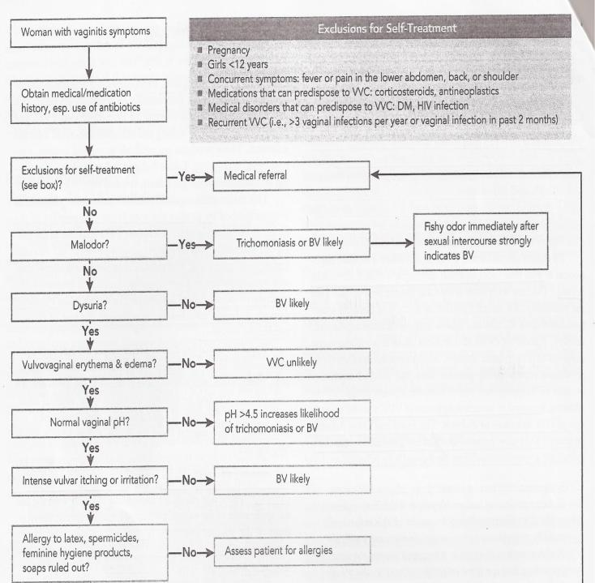
Self-care of VVC

Slide 23
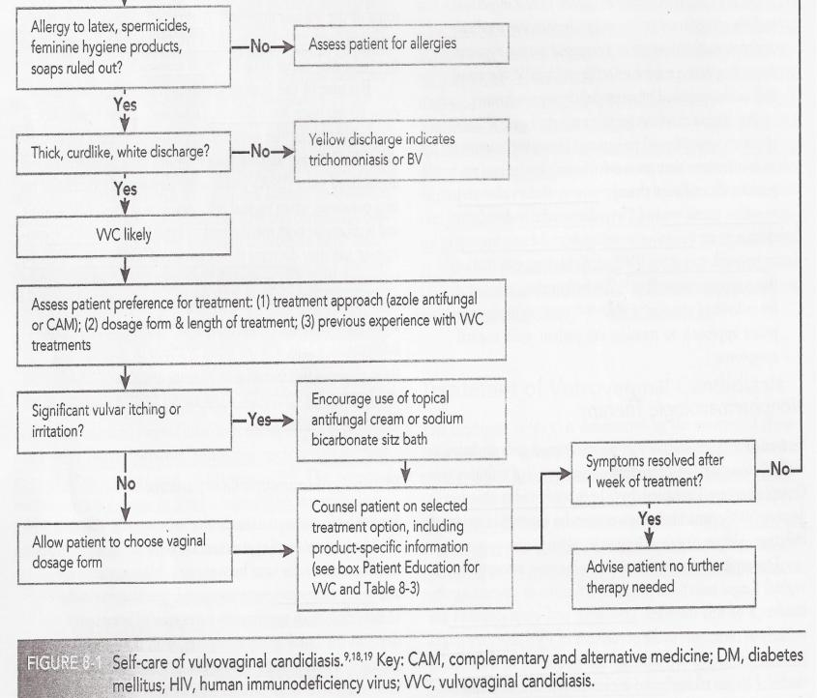

Slide 24
Nonpharmacologic Therapy
飲食改變，少攝取蔗糖和精製碳水化合物，多食用優格
停用會造成陰道感染機率增加的藥物，如：口服避孕藥、廣效抗生素、免疫抑制劑
→抗生素和免疫抑制劑停用前需諮詢醫生
不穿不吸汗、透氣差的衣物
→念珠菌喜歡生長於溫暖潮濕的環境裡，若穿著不透氣的內衣褲則較容易感染

Slide 25
Pharmacologic Therapy (1)
Nonprescription FDA- approved imidazole ( Butoconazole , Miconazole , Triconazole , clotrimazole) product is the recommended initial therapy for uncomplicated VVC.
Dosage form：creams、suppositories、tablets
Mechanism：alter the membrane permeability of the fungi
  Inhibit CYP450 in the fungal sterol membrane
  → decreasing synthesis of the essential fungi sterol ergosterol
  → increase in lanosterol-like methylated sterols
  → cause structural damage to fungal membrane
Side effect ：Vulvovaginal buring, itching, irritation, abdominal cramps, penile irritation, headache, allergy

Slide 26
Pharmacologic Therapy (2)
Interaction：
  有篇case report提到miconazole陰道塞劑會和warfarin產生交互作用，病人的INR升高。可能原因為miconazole抑制CYP2C9，造成warfarin清除率減少，濃度變高
  使用Nonprescription vaginal antifungal 產品須告知和warfarin併用會有出血的風險
  Allergy
  除此之外無其他產品禁忌症 → 因為是局部作用，吸收較差

Slide 28
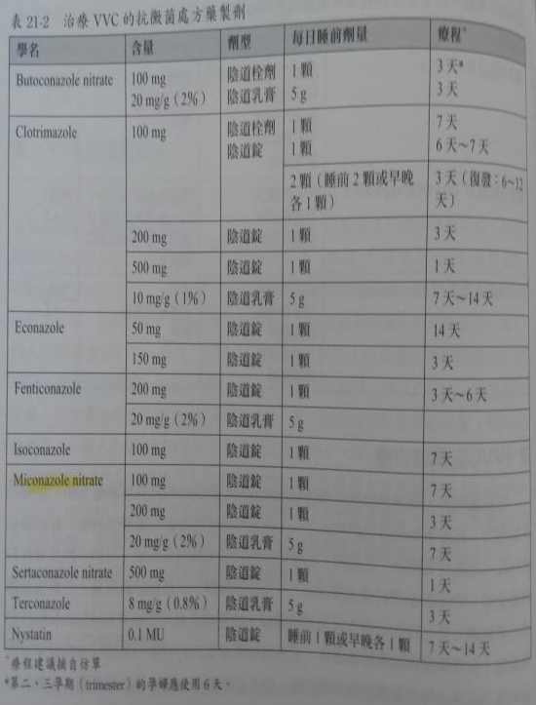
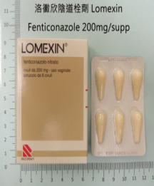
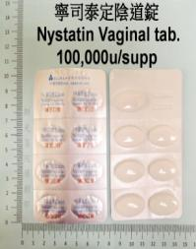
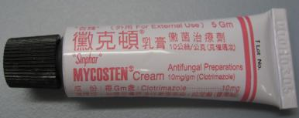
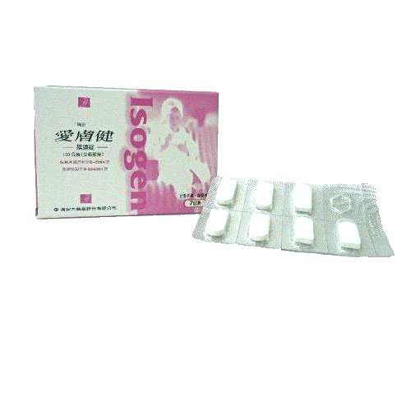
Isoconazole 100mg/supp

Slide 29
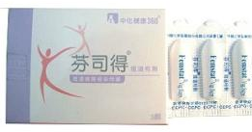
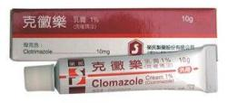
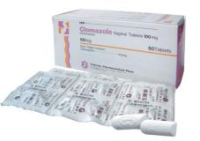
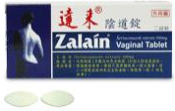
學名 | 商品名 | 含量 | 劑型 | 類別
Butoconazole nitrate | 芬司得 Femstat | 100mg | 陰道栓劑 | 處方藥
 |  | 20mg/g(2％) | 陰道乳膏 | 處方藥
Clotrimazole | 克黴樂乳膏 | 10mg/g(1％) | 陰道乳膏 | 指示藥
 | 克黴樂陰道錠 | 100mg | 陰道錠 | 處方藥
 | "皇佳" 婦淨喜陰道錠 | 200mg
 | "汎生"克催瑪汝陰道錠 | 500mg
Econazole | 益可樂陰道栓劑 | 50mg | 陰道栓劑 | 處方藥
 | 剋黴栓劑 | 150mg

Slide 30
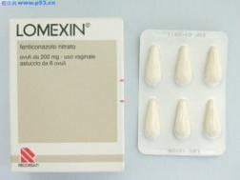
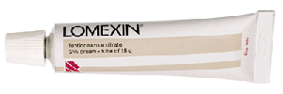

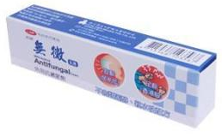
學名 | 商品名 | 含量 | 劑型 | 類別
Fenticonazole | 洛黴欣陰道軟膠囊 | 200mg | 陰道軟膠囊 | 處方藥
 | 洛黴欣乳膏 | 20mg/g(2％) | 陰道乳膏 | 處方藥
Isoconazole | "瑞安" 愛膚健陰道錠 ISOGEN | 100mg | 陰道錠 | 處方藥
Miconazole nitrate | 無黴乳膏 | 20mg/g(2％) | 外用乳膏 | 指示藥
 | 無黴陰道錠 | 100mg | 陰道錠 | 處方藥

Slide 31

學名 | 商品名 | 含量 | 劑型 | 類別
Sertaconazole | 達來陰道錠 ZALAIN | 500mg | 陰道錠 | 處方藥
Terconazole | "信隆" 德克娜 TERCONER | 8mg/g(0.8％) | 陰道乳膏 | 處方藥
Nystain | 寧司泰定陰道錠 | 0.1MU | 陰道錠 | 處方藥

Slide 32
OTC for Vaginal Itching & Irritation
陰道刺激、搔癢、不適、性交疼痛、有分泌物等輕微症狀可能並無特定原因造成，發生率也不清楚，但愈早有性行為者，愈可能產生搔癢與分泌物的問題
衛生問題、對女性私密處衛生用品中的成分過敏或對塵螨過敏都有可能導致上述症狀
若無特殊健康問題，可自行使用含優碘或類固醇等外用藥品緩解症狀
      Benzocaine 5% or 20%
      Hydrocortisone 0.5% or 1%
      Povidone/iodine 10%

Slide 33
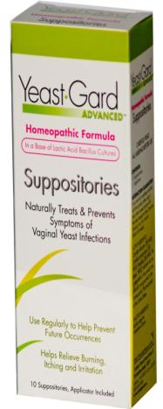
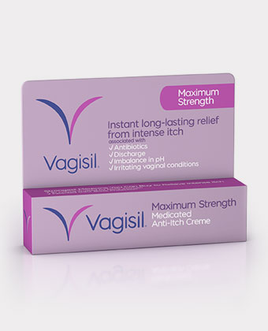
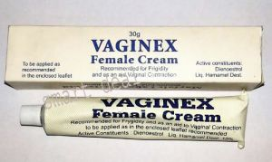
Several other nonprescription
Vagisil and Yeast-Gard ( benzocaine and resoucinol ) and Vaginex (tripelennamine) are used for the relief of itching.
Advantages：
  Superior efficacy
  Increasing compliance with easily use
  Shorten duration

Slide 34
Product Selection Guide (1)
12歲以下小女孩：
  不適合自我照護，需要轉介到醫院檢查感染原因
  有被性虐待的可能
懷孕：
  有可能造成新生兒敗血症、鵝口瘡
  懷孕的前三個月最好先不要給藥
  自我照護較不適合
  不能用口服藥，以外用藥(Butoconazole、Clotrimazole、Miconazole)為主
  需評估是否有併發症，如：糖尿病，以及其他陰道疾病，因細菌性陰道炎和滴蟲性陰道炎都會對胎兒有不良影響
哺乳婦女和老人在使用OTC上較無問題

Slide 35
Product Selection Guide (2)
可依病人偏好選擇錠劑、栓劑、乳霜、軟膏等劑型，都是外用藥
復發的病人可能偏好療程較短的藥物
症狀較嚴重時，可以單獨使用乳霜或額外再加上栓劑或錠劑

Slide 36
How to Apply Vaginal Antifungal Products
陰道栓劑該如何使用：
    使用前先清潔手及外陰部，等到全乾後再開始使用藥品
    仰躺，雙腳往腹部彎曲，雙腿分開，將栓劑用手指推到陰道深處，約兩個食指指節深。
    陰道栓劑通常在睡前使用，讓藥品有足夠的時間溶化吸收，躺下也可防止藥品流出。
    使用後如果有黏稠或水水的液體流出來，這些都是屬於正常現象，不須過度緊張。
    陰道栓劑即使在月經期間，仍要繼續用藥，除非醫師有特別指示，不可自行停用。
    陰道栓劑使用期間應該儘量避免性交，避免伴侶間互相感染。
注意事項：
    給藥期間可使用護墊或衛生棉以避免汙染底褲，千萬不可使用衛生棉條，因為衛生棉條會吸收藥品而導致治療效降低
    陰道抗黴菌製劑可能會損壞保險套而導致避孕失敗，需提醒病人應加上第二種避孕措施
如何保存栓劑：
栓劑需要保存在兒童無法拿到的陰涼處，避免高溫或日照，除非特別指示，否則大部分的栓劑不需特別放在冰箱儲存。

Slide 37
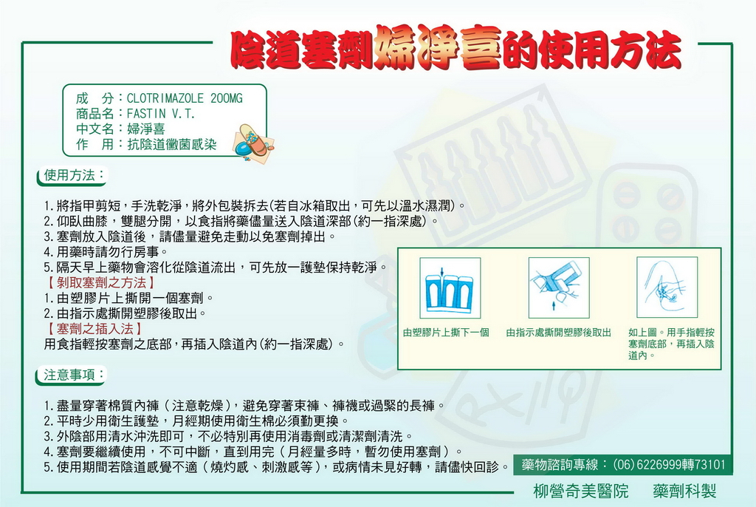

Slide 38
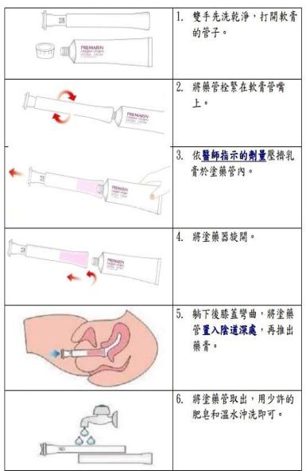
Guidelines for Applying Vaginal
Antifungal Products
陰道軟膏使用方法

Slide 39
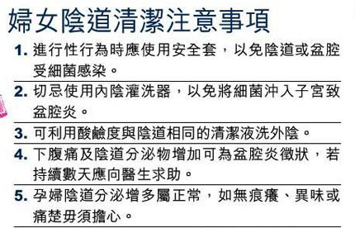
Q&A
Q：需要每天使用陰道沖洗液？
A：不需要，因局部清潔劑大多為鹼性，頻繁使用或濃度過高時，會造成陰道酸鹼度改變，陰道正常菌落減少，反而易造成其他致病菌落繁殖，而導致陰道炎。
Q：月經來時可使用陰道栓劑嗎？
A：如果病情許可，建議在月經過後使用藥品。一般陰道用藥治療的多為感染性疾病，如子宮頸糜爛、滴蟲或黴菌性陰道炎等，必須按醫療人員的指示用藥。經期仍要繼續用藥，不可擅自中斷。月經會縮短藥品停留在陰道的時間，而導致效果較差。

Slide 40
Complementary Therapies (1)
Lactobacillus
  Reestablish normal vaginal flora and inhibit overgrowth of Candida organisms
Yogurt (8 ounces daily)
  prevents recurrent VVC
  And decrease sugar and refined carbohydrates in diet
Sodium bicarbonate sitz bath(碳酸氫鈉澡浴)
  Provide prompt relief of vulvar irritation
  Sitz bath for 15 mins for symptom control
    泡法1：1 teaspoon (5 mL) NaHCO₃ →1 pint (568 mL) of water
    泡法2：2-4 tablespoons (40-80 mL) of the solution→2 inches (5.08 cm) of bath water

Slide 41
Complementary Therapies (2)
Tea tree oil
  Antibacterial and antifungal properties
    Lactobacillus more resistant to tea tree oil than BV organisms
  200 mg vaginal suppository used for 6 nights
  Disadvantage：Possibility of allergic dermatitis exists
Gentian violet 龍膽紫
  Topical therapy for resistant candidal infections
  Tampon soaked in the dye and inserted into the vagina for several hours or overnight
    Often single application is adequate, can be used QD or BID for up to 5 consecutive days
  Disadvantage: Stain fabrics and skin

Slide 42
Complementary Therapies (3)
Boric acid
  600 mg boric acid in size 0 capsule inserted vaginally QD or BID for 14 days
  5% in lanolin(羊毛脂) topically for vulvar irritation
  Particularly useful (85%-95%) for non-C. ablicans and antifungal resistant infections
  Disadvantage
    Toxic ： Fatalities have been reported from oral ingestion
    Teratogenic ： Pregnant women should not use(有致畸胎性)

Slide 43
Outline
1. Anatomy and physiology of the vagina
2. Differentiation of common vaginal infections
3. Vulvovaginal candidiasis
4. Atrophic vaginitis
5. Vaginal douching

Slide 44
Atrophic Vaginitis 萎縮性陰道炎
Inflammation of the vagina related to atrophy of the vaginal mucosa secondary to decreased estrogen levels
Estimated 10-40% of postmenopausal women have symptomatic atrophic vaginitis, but only 20-25% seek treatment

Slide 45
Pathophysiology
Decrease in estrogen levels → Vaginal epithelium becomes thin → Vaginal lubrication declines when
  Menopause
  Postpartum period
  Breast feeding
Risk factors for a decrease in ovarian estrogen production
  Radiation therapy
  Chemotherapy
  Antiestrogenic medications
    Clomiphene, Medroxyprogesterone, Tamoxifen, Raloxifene, Danazol, Leuprolide, Nafarelin
  Low-estrogen oral contraceptive (Rarely)
    Due to nonphysiologic / undesirable estrogen-progestin balance

Slide 46
Clinical Presentation of Atrophic Vaginitis
Decrease in vaginal lubrication
  Early symptom of atrophic vaginitis
  Cause dyspareunia 性交疼痛
Vaginal irritation
Dryness
Burning
Itching
Leukorrhea
Thin, watery (occasionally bloody), or yellow malodorous discharge
Vaginal bleeding
  Postmenopausal vaginal bleeding needs to be evaluated if endometrial cancer

Slide 47
Treatment of Atrophic Vaginitis (1)
Goals
  Reduce the symptoms of vaginal dryness, burning and itching
  Eliminate dyspareunia
Self-treatment with lubricant products can only alleviate primary symptom-vaginal dryness
  Breast-feeding or have recently given birth needed lubricants only until estrogen levels return to normal
Prescription estrogen therapy for preventing vaginal dryness requires
  Recommended for women at menopause
  Topical estrogen products (creams or tablets) have limited systemic estrogenic effects

Slide 48
Treatment of Atrophic Vaginitis (1)
Self-treatment appropriate when symptoms
  Mild to moderate
  Confined to the vaginal area (localized)
  No bleeding
  Previously been able to maintain adequate vaginal lubrication
Avoid products aggravate vaginal symptoms
  Powders
  Perfumes
  Spermicides
  Panty liners

Slide 49
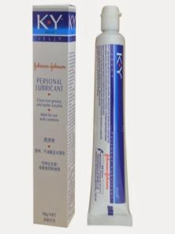
Vaginal Lubricants
Water-soluble lubricants provide relief from burning and itching, and facilitate sexual intercourse
Can be applied both externally and internally with quantity and frequency depends on one’s specific needs
  Short term：Breast-feeding, recently gave birth
  Long term：Perimenopause, postmenopause
Not use petroleum jelly (Vaseline)
  Difficult to remove from vagina
  Nonwater-soluble lubricants may damage the efficacy of latex condom or diaphragm

Slide 50
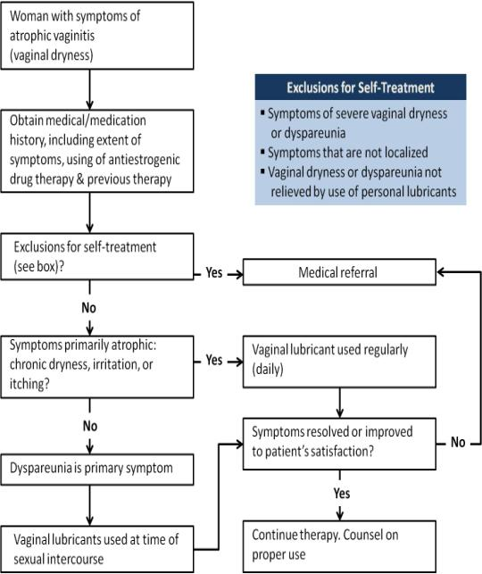
Self-care of Atrophic Vaginitis

Slide 51

Patient Education
Apply the lubricant as frequently as needed for relief of symptoms (vaginal dryness, irritation, burning or itching)
Begin with a liberal quantity of lubricant (2 teaspoons); tailor subsequently to the quantity of use needed.
If using at the time of sexual intercourse, apply to the vagina, particularly at the vaginal opening, and to the penis.
Some leakage of product will occur. If desired, use a sanitary or panty liner to avoid staining of underwear.
Relief of symptoms may be apparent within hours after the first dose. Regular application of a lubricant can reverse atrophic symptoms to some extent.
If no improvement is noticeable within a week, or if symptoms worsen or there is any vaginal bleeding, search for medical referral.

Slide 52
Outline
1. Anatomy and physiology of the vagina
2. Differentiation of common vaginal infections
3. Vulvovaginal candidiasis
4. Atrophic vaginitis
5. Vaginal douching

Slide 53
Prevalence of Douching
Douching rates are influenced by race, geographic region, socioeconomic status, and education.
Most women who report douching that they begin the practice as adolescents.
Women residing the South are more likely to douche.
 | 高中肄業 | 大學畢業
黑人婦女 | 70％ | 40％
白人婦女 | 53％ | 9％

Slide 54
Reasons for douching???
The most frequently started reason for douching is to achieve good vaginal hygiene, and most reported douching after menstruation and sexual intercourse.
Another reported reason for douching is to enhance the sexual experience.
50％ of adolescents in one survey had heard that douching could dry and tighten the vagina for sexual purposes.

Slide 55
Potential Adverse Effects of Douching (1)
Studies have not shown douching to be either safe or desirable.
Frequent douching has been associated with :
  Increase risk for PID
  Reduce fertility
  Ectopic pregnancy
  Vaginal infections
  Sexually transmitted infections
  Low birth weight
  Cervical cancer
Notes:
Reduce fertility降低生育能力

Slide 56
Potential Adverse Effects of Douching (1)
Additional possible problems：
  Irritation or sensitization from douche ingredients
  Disruption normal vaginal flora and pH .
The effect of douches on vaginal flora varies depending on the douche ingredients and douching frequency .

Slide 57
Commonly used douche (1)
Water/vinegar(acetic acid)：
  Little to no effect on lactobacilli, but inhibited some vaginal pathogens.

Slide 58
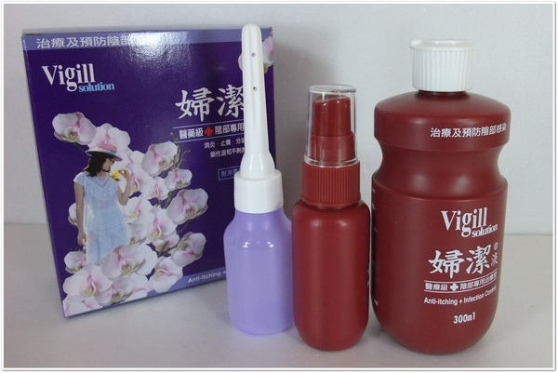
Commonly used douche (2)
    Povidone/iodine(Betadine)：
  Greater potential to reduce total bacteria (antiseptic effect) →may allow pathogenic species to proliferate, increasing the risk of vaginal infection
  Povidone/iodine should not be used by individuals allergic to iodine-containing products.
  In pregnant women, may result in iodine induced goiter and hypothyroidism in the fetus.
主成份普威隆碘(Povidone Iodine) ，有效緩解及預防因細菌、黴菌(念珠菌)、滴蟲所引起之搔癢、發炎、分泌物、異味等陰部感染症狀。

Slide 59
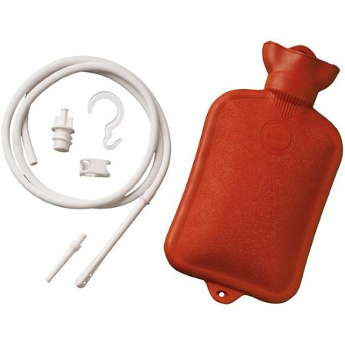
Proper Use of Douche Equipment
Two types：douche bag & bulb douche syringe
Douche Bag (fountain syringe)：
  Holds 1 - 2 quarts of fluid, and comes
  with tubing and a shutoff valve.
  Two types of tips：one for enema(灌腸)
  and one for douching. Two tips are not
  interchangable.
tubing
Water
bottle
Adapter
cap
hook
Shut-off
clamp
Enema
pipe
Vaginal pipe

Slide 60
Proper Use of Douche Equipment
Instruction for the douche bag
  ⇒Fill the bag with the prescribed solution or with warm water and vinegar solution.
  ⇒Lie back in the tub with knee bent. Place the douche bag one foot above the height of your hips.
  ⇒Insert the nozzle(噴頭) several inches into the vagina. Release the clamp slowly to allow the fluid to enter the vagina. Stop the fluid when the vagina feels full; then holds for 30-60s.
  ⇒Release and allow the fluid to flow out.
  ⇒Wash the nozzle with mild soap and water.

Slide 61
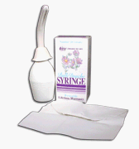
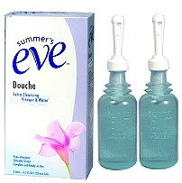
Proper Use of Douche Equipment
Bulb Douche Syringe：
  Disposable & nondisposable
  The flow rate is regulated by the amount of
  hand pressure exerted when the bulb is squeezed.
  Gentle pressure is recommended, because
  excess pressure may force fluid through the
  cervix, causing uterine inflammation.

Slide 62
Proper Use of Douche Equipment
Instruction for the bulb douche syringe：
  ⇒Choose a douching position：
  (1) sitting on the toilet or (2) standing in the shower
  ⇒Gently insert the nozzle about 3 inches into your vagina.
  ⇒Squeeze bottle gently, letting the solution cleanse the vagina
  and then flow freely from the body.
  ⇒After douching, throw away bottle and nozzle, if disposable.

Slide 63
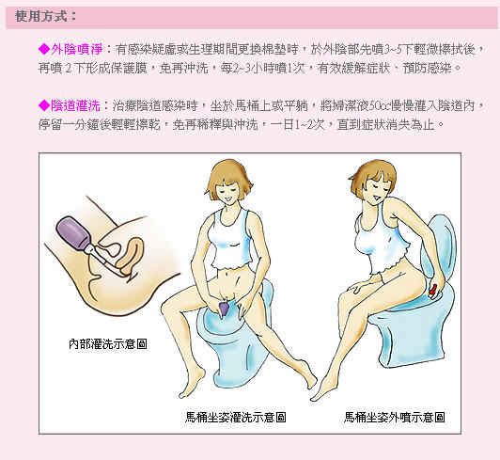

Slide 64
Patient Counseling for Douching
Practitioners should discuss reasons for douching.
Douching is not necessary for cleansing of the vagina and that it has potential adverse consequences.
  Douching for routine hygienic purposes should be discouraged.
  Do not douche during pregnancy unless under advice.
Should be delayed at least 6 to 8 hours after sexual intercourse if a vaginal spermicide was used as a contraceptive agent.

Slide 65
Patient Counseling for Douching
Alternative cleansing ： Gently washing the vagina and the vulvar, perineal, and anal regions with the fingers using lukewarm water and mild soap.
If a woman is douching to prevent or treat symptoms of a vaginal infection, she should be counseled about more effective therapy.

Slide 66
Key points for the chapter
Vaginal symptoms are often nonspecific, and it may be difficult to distinguish the three common vaginal infections.
To differentiate a candida infection from BV and trichomoniasis is the absence of an offensive odor to the vaginal secretion.
Measurement of vaginal pH (pH>4.5 indicates a noncandidal infection) help to distinguish Candida.
Vaginal candidal infections are typically caused by C. albicans, but recently non-C. albicans infections have increased(more resistant to azole antifungals).

Slide 67
Key points for the chapter
Self-treatment for a vaginal candida infection is most appropriate when woman’s symptoms are mild to moderate.
Patient should be informed that symptoms typically improve shortly after application of the vaginal antifungals; symptoms should improve within 2-3 days after initiation of therapy and be resolved within a week.
Use of a sodium bicarbonate sitz bath can provide relief of itching and irritation
Eating yogurt with live cultures (8 ounces daily) may be of some benefit to patients in preventing recurrent VVC infections.

Slide 68
Key points for the chapter
Atrophic vaginitis can occur after menopause, postpartum, during breast-feeding, or as a result of antiestrogenic medications.
Vaginal dryness and dyspareunia can be relieved by use of topical personal lubricant products. If symptoms do not improve within a week, medical evaluation is needed.
Atrophic vaginitis may cause vaginal bleeding; however any postmenopausal bleeding needs to be evaluated to rule out endometrial cancer.
Douching is not necessary for vaginal cleansing, and adverse consequences can occur. Douching is contraindicated during pregnancy and should be postponed until at least 8 hours after sexual intercourse if a vaginal spermicide was used for contraception.

Slide 69
References
Krinsky DL, Berardi RR, Ferreri SP, et al. Handbook of nonprescription drugs :An interactive approach to self-care. 17th ed. Washington, D.C.: American Pharmacists Association; 2012.

Slide 70


